Slide 1
ZEPTO ANALYSIS
Analyzing Business Performance Using Real-World Data with SQL

Slide 2
About Us
Stands out in market:-This project stands out by using real business data and practical SQL queries to generate meaningful insights that can be directly used for decision-making.
Innovative features:-The project applies advanced SQL concepts like joins, subqueries, window functions, and aggregations to analyze data efficiently and uncover hidden patterns.
Provides unique solution:-Instead of just storing data, this project focuses on converting raw data into actionable insights that help improve sales, customer understanding, and delivery performance.
Edge over competitors:-By combining multiple datasets and performing deep analysis, the project offers more detailed and accurate insights compared to basic reporting methods.
User-focused design:-The analysis is structured in a clear and logical way, making it easy for users to understand results and apply insights without technical complexity.
Prioritizes user experience:-The outputs are designed to be simple, readable, and business-friendly, ensuring that stakeholders can quickly understand findings and make informed decisions.

Slide 3
Product overview
The products in this project represent items sold by the company across different categories. By analyzing product sales, pricing, and demand, we identify which products perform well, which need improvement, and how product performance impacts overall revenue.

Slide 4
DATASET OVERVIEW
📁 Dataset Overview:-
The dataset was sourced from Kaggle and is based on Zepto’s real product listings, closely representing a real-world e-commerce inventory system.
Each row represents a unique SKU. Duplicate product names appear due to variations in size, weight, pricing, discounts, or categories, which is common in actual online product catalogs.
Columns include:
sku_id – Unique product identifier
name – Product name
category – Product category
mrp – Maximum Retail Price (₹)
discountPercent – Discount on MRP
discountedSellingPrice – Final selling price (₹)
availableQuantity – Inventory stock level
weightInGms – Product weight in grams
outOfStock – Stock availability flag
quantity – Units per package

Slide 5
BUSINESS INSIGHT
1.Found top 10 best-value products based on discount percentage
2.Identified high-MRP products that are currently out of stock
3.Estimated potential revenue for each product category
4.Filtered expensive products (MRP > ₹500) with minimal discount
5.Ranked top 5 categories offering highest average discounts
6.Calculated price per gram to identify value-for-money products
7.Grouped products based on weight into Low, Medium, and Bulk categories
8.Measured total inventory weight per product category

Slide 6
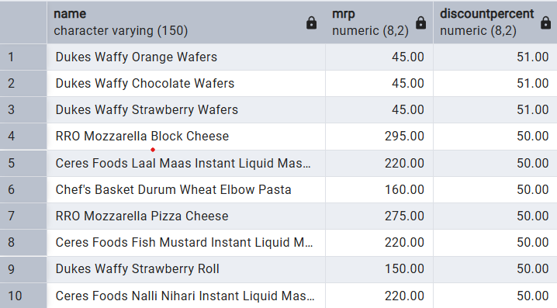
1.Found top 10 best-value products based on discount percentage
select distinct name , mrp ,discountPercent from zepto order by discountPercent desc limit 10;

Slide 7
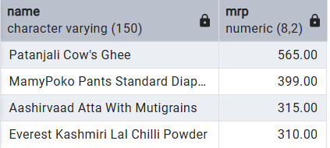
2.Identified high-MRP products that are currently out of stock
select distinct name , mrp
from zepto
where outofStock = TRUE
and mrp > 300
order by mrp desc;

Slide 8
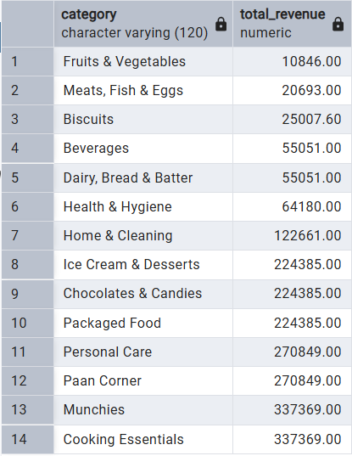
3.Estimated potential revenue for each product category
select category ,
sum(discountedSellingPrice * availableQuantity )
as total_revenue
from zepto
group by category
order by total_revenue;

Slide 9
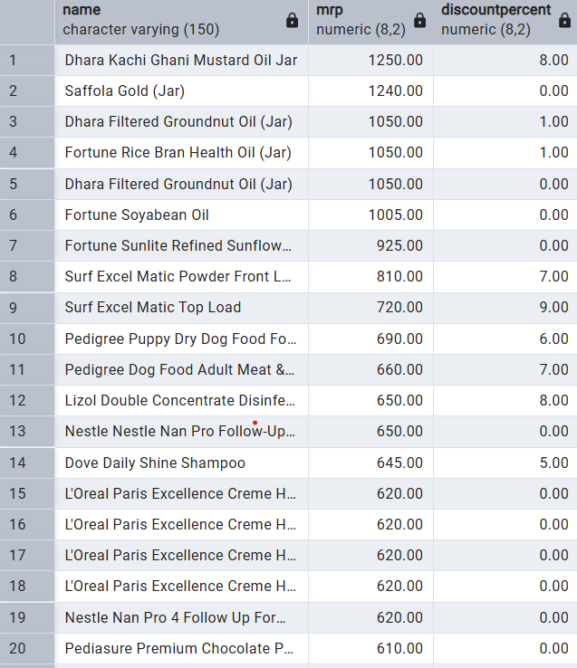
4.Filtered expensive products (MRP > ₹500) with minimal discount
select distinct name ,mrp ,discountPercent
from zepto
where mrp > 500 and discountPercent < 10
order by mrp desc , discountPercent desc;

Slide 10
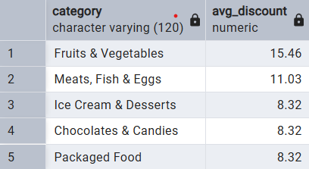
5.Ranked top 5 categories offering highest average discounts
select category,
round(avg(discountPercent),2) as avg_discount
from zepto
group by category
order by avg_discount desc
LIMIT 5 ;

Slide 11
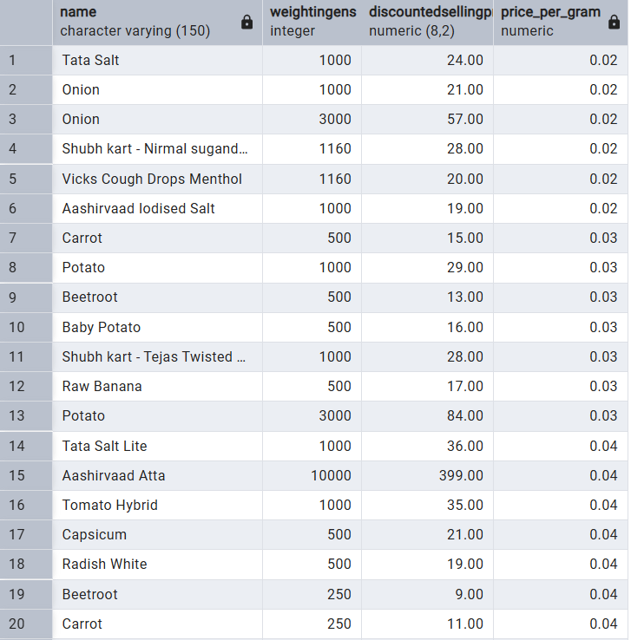
6.Calculated price per gram to identify value-for-money products
select distinct name , weightInGens , discountedSellingPrice,
round(discountedSellingPrice / weightInGens,2) as price_per_gram
from zepto
where weightInGens >= 100
order by price_per_gram;

Slide 12
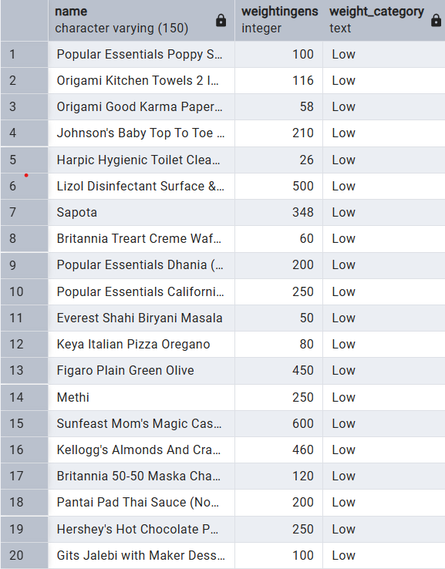
7.Grouped products based on weight into Low, Medium, and Bulk categories
select distinct name ,weightInGens,
case when weightInGens < 1000 then'Low'
when weightInGens < 5000 then'Medium'
else 'Bulk'
end as weight_category
from zepto;

Slide 13
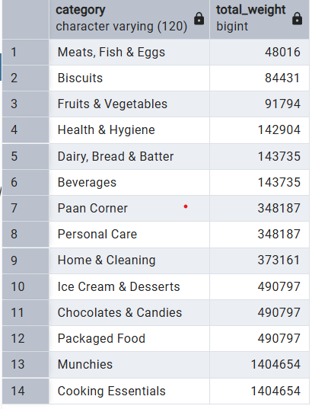
8.Measured total inventory weight per product category
select category ,
sum(weightInGens * availableQuantity) as total_weight
from zepto
group by category
order by total_weight;

Slide 14
THANK YOU
VIKAS SIDDHESHWARE
vikassiddheshware2001@gmail.com

